Slide 1



AMR Sentinel
Team X | Shobhit university | J2

Slide 2

agenda
Mitigating Outpatient Antimicrobial Resistance (AMR) via Point-of-Care Multi-Agent Clinical Prescription Auditing and Guideline Enforcement
Index
AMR
Core problem/Cause
Action Plan
Impact
Summary

Slide 3

AMR

Slide 4

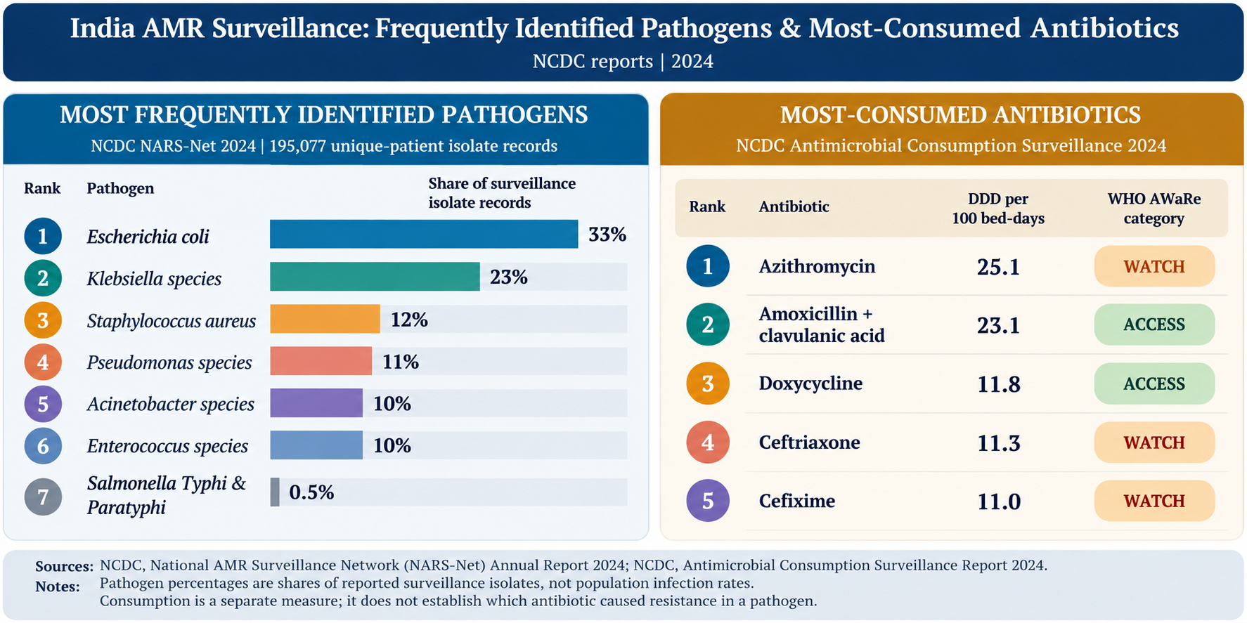
AMR
Anti-Microbial Resistance

Slide 5
CASE Study
This study will talk about three cases for when a patient is diagnosed with UTI
Case A
  Conventional Medicine
Case C
  Ayurvedic
Case B
  Homeopathy

Slide 6



Competitive landscape
Conventional
Recurrent MDR Klebsiella pneumoniae UTI in a kidney-transplant recipient.
Treatment failure required reassessment and surgical source control.
Homeopathic
Two published cases of antibiotic-resistant recurrent UTI.
Reported improvement; controlled evidence remains insufficient to establish efficacy.
Ayurvedic
E. coli UTI treated with Varividaryadi Kashaya in a single-patient report.
Follow-up culture was reported negative; AMR was not established.

Slide 7
Core Problem
Point-of-Care Bottleneck
ICMR Standard-Point Blank
Overprescription
OPD: Race Against Time
Cognition X Manuals

Slide 8





Action Plan
Clinic Ai Agent
Prescript guidance
Efficiency X Effectivity
Sustainability

Slide 9
















Tech Stack
(Action Plan 0.1)
Frontend
Shad cn
Framer motion
Next.js
Tailwind css
Rechart
lucide
Backend
Python
Fastapi
Pydantic
Sqlalcemy
Psycopg
Postgresql
Pytest
AI & RAG
Langgraph
Llama index
Gemini 2.5 flash
Openrouter api
Pgvector
rank_bm25
BAAI/bge-reranker
Rapidfuzz
okf

Slide 10
IMPACT & Future scope
Reducing Irrational Antibiotic Prescribing
  Prescription audit
Slowing the Spread of Antimicrobial Resistance
  Avoidable Anti-microbial exposure
Smarter Healthcare System
  Practicality and productivity
Real Time Surveillance
  Hospital & Regional Integrations
Clinical Personalization
  Patient Specific Audit
AMR Intelligence
  Awareness and Stewardship

Slide 11
Summary
AMR
India’s AMR Surveillance
WHO AMR Guard
AMR Sentinel
Impacts & Scope
Sources
WHO
NCDC
ICMR
HRI
JETIR.org
international journal of homeopathic science
science direct
pubmed
AYU (An International Quarterly Journal of Research in Ayurveda
PIB
Ayush

Slide 12

Thank you
Team x | Shobhit university

